Slide 1
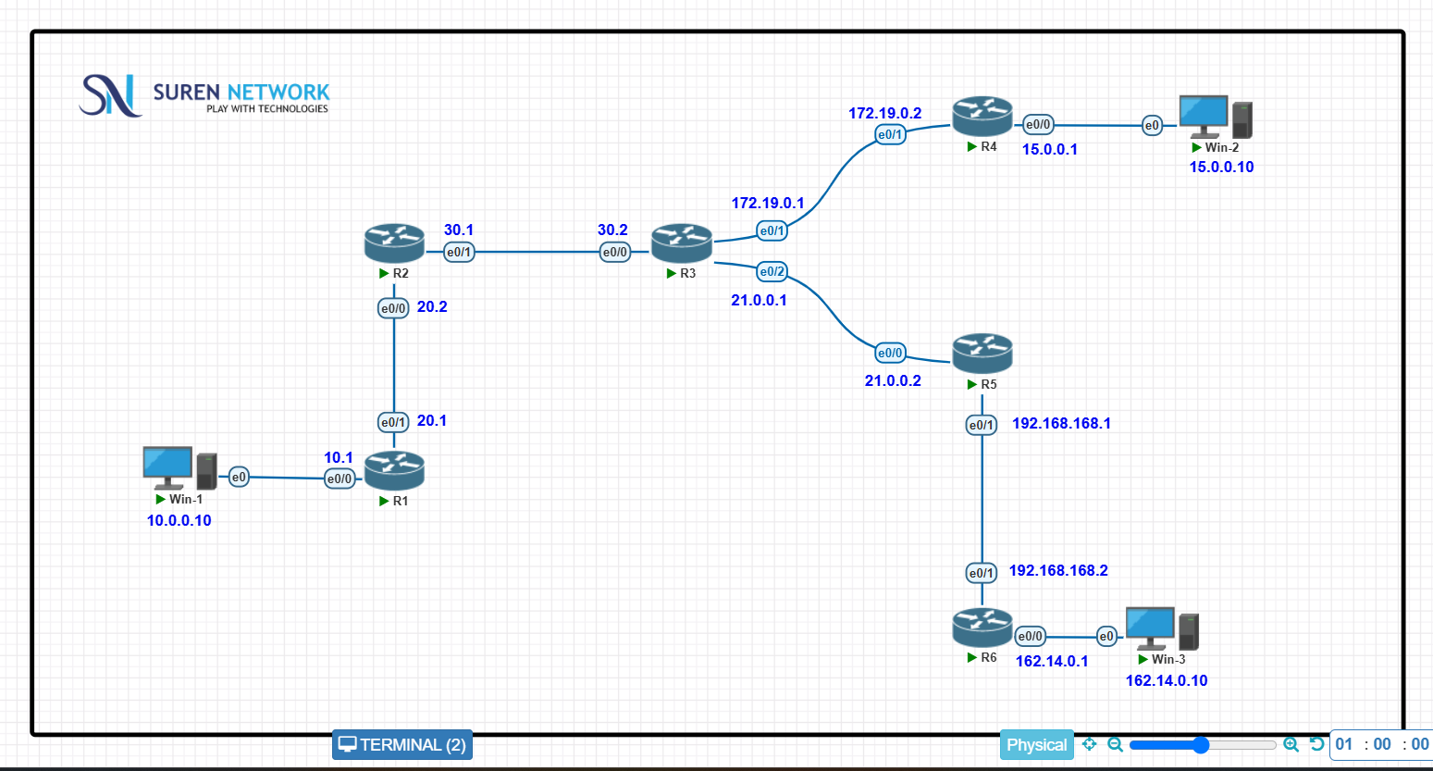

Slide 2
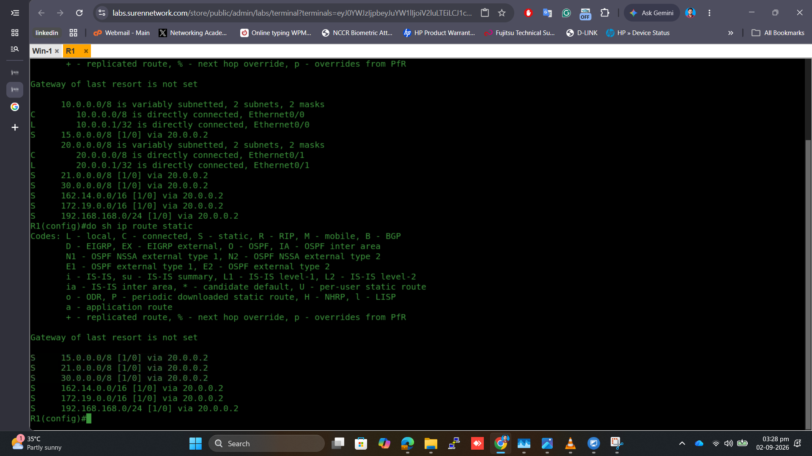
Manually added a static route to the router (R1)

Slide 3
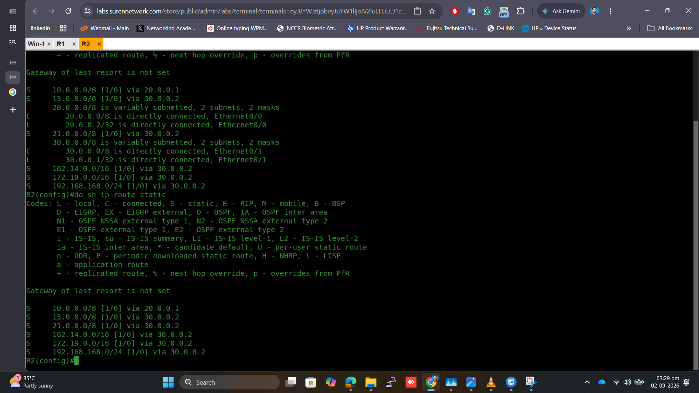
Manually added a static route to the router (R6)

Slide 4

Manually added a static route to the router (R3)

Slide 5
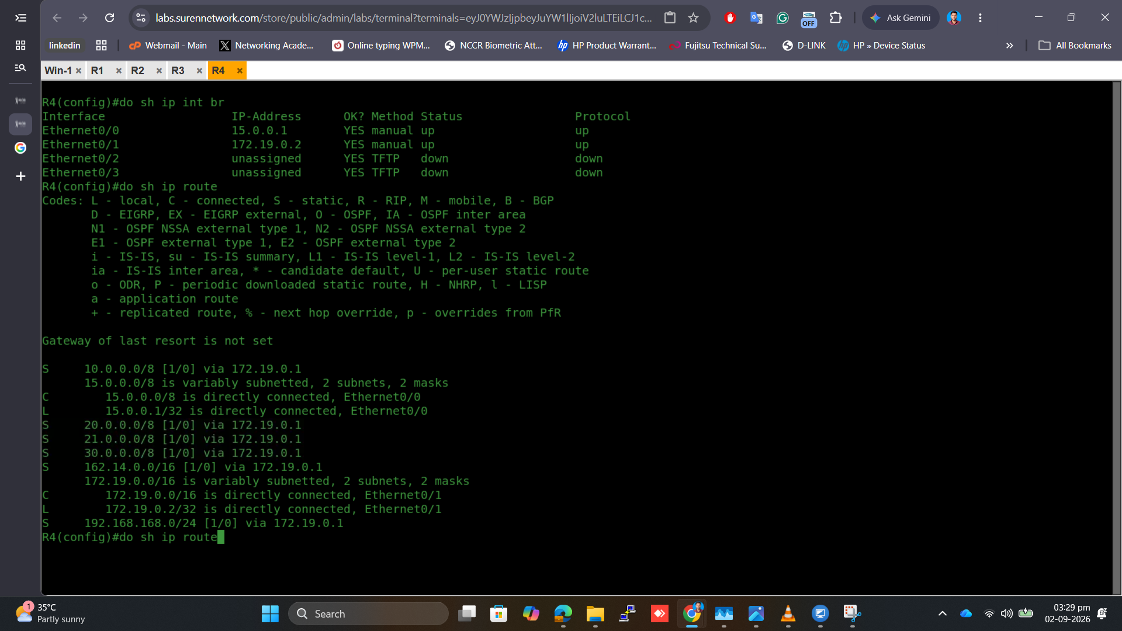
Manually added a static route to the router (R4)

Slide 6
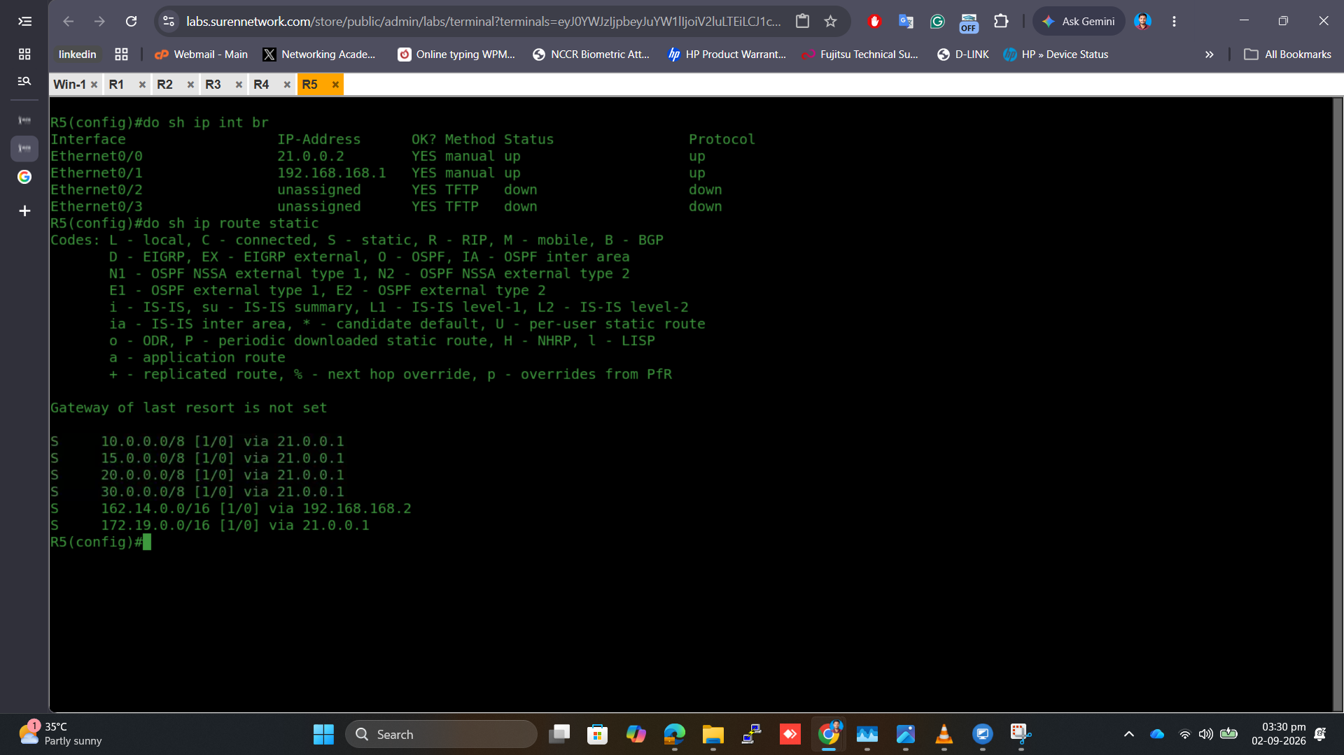
Manually added a static route to the router (R5)

Slide 7
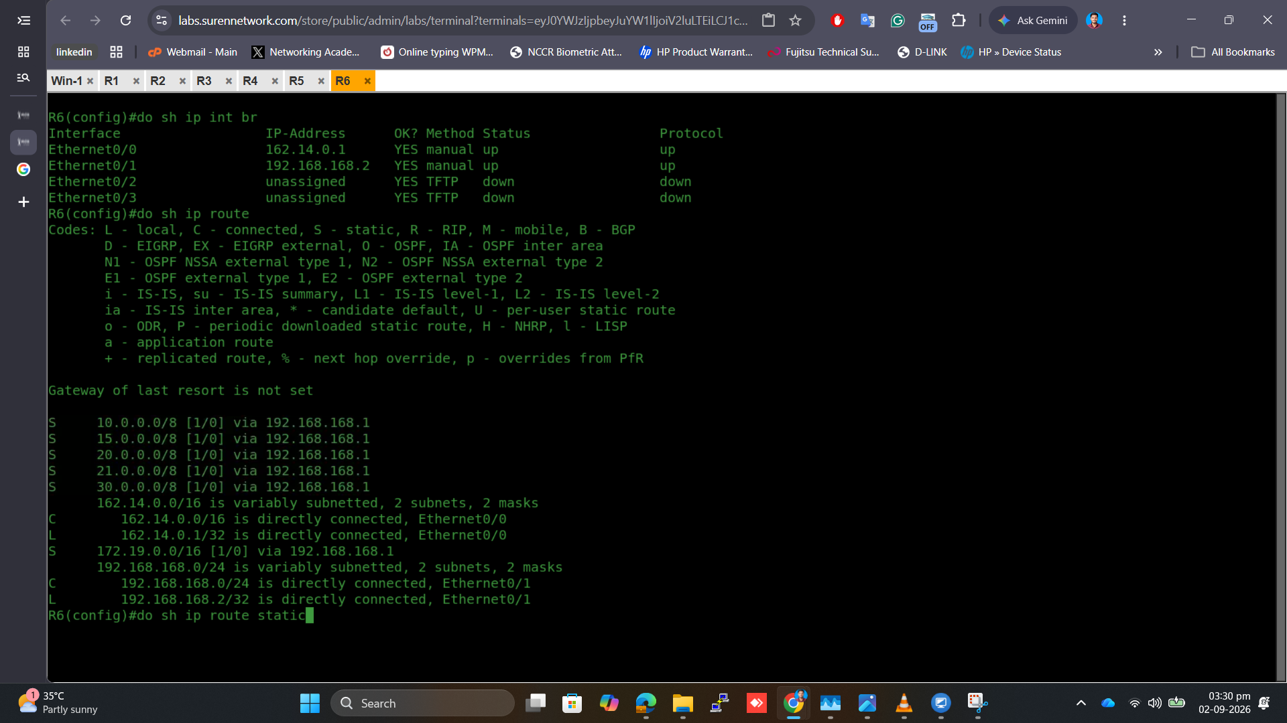
Manually added a static route to the router (R6)

Slide 8
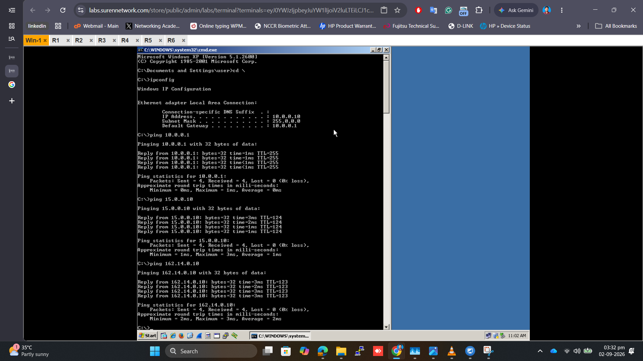
Successfully reached all the PC’s IPs

Slide 9
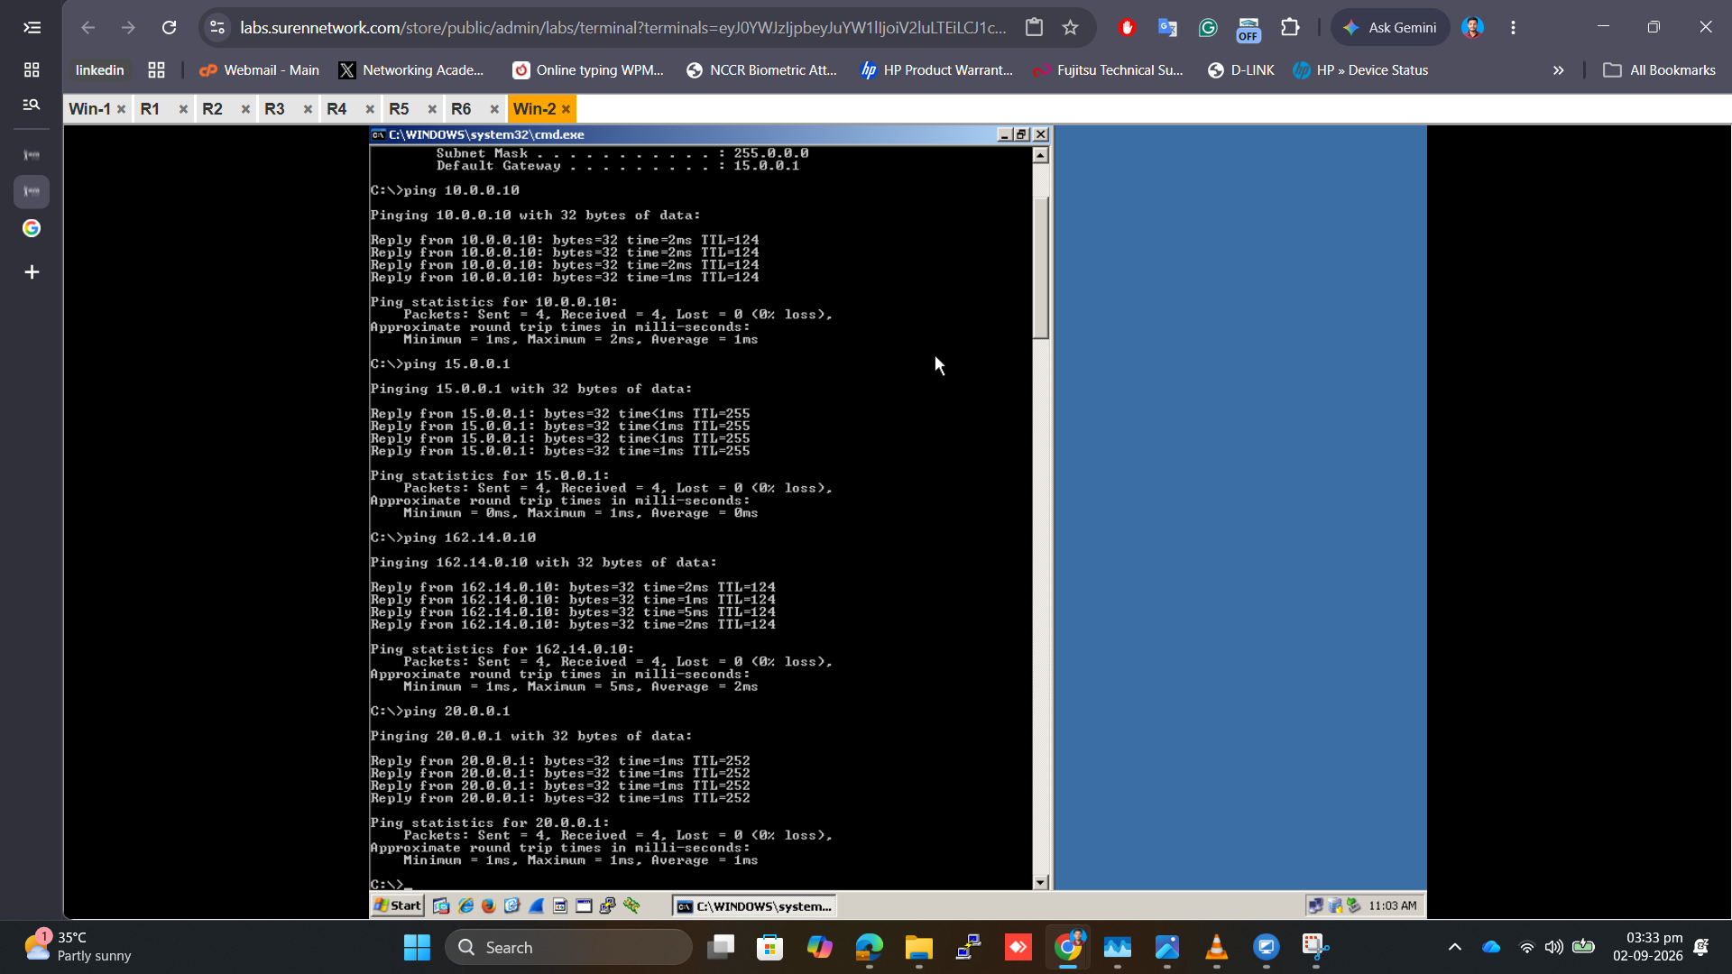
Successfully reached all the PC’s IPs

Slide 10
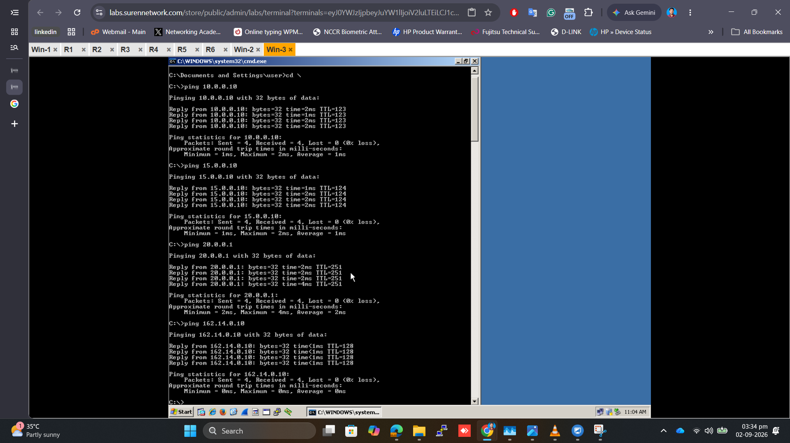
Successfully reached all the PC’s IPs

